Slide 1
Predictive Calculator
Investigation of Neural Network arithmetic capabilities

Slide 2
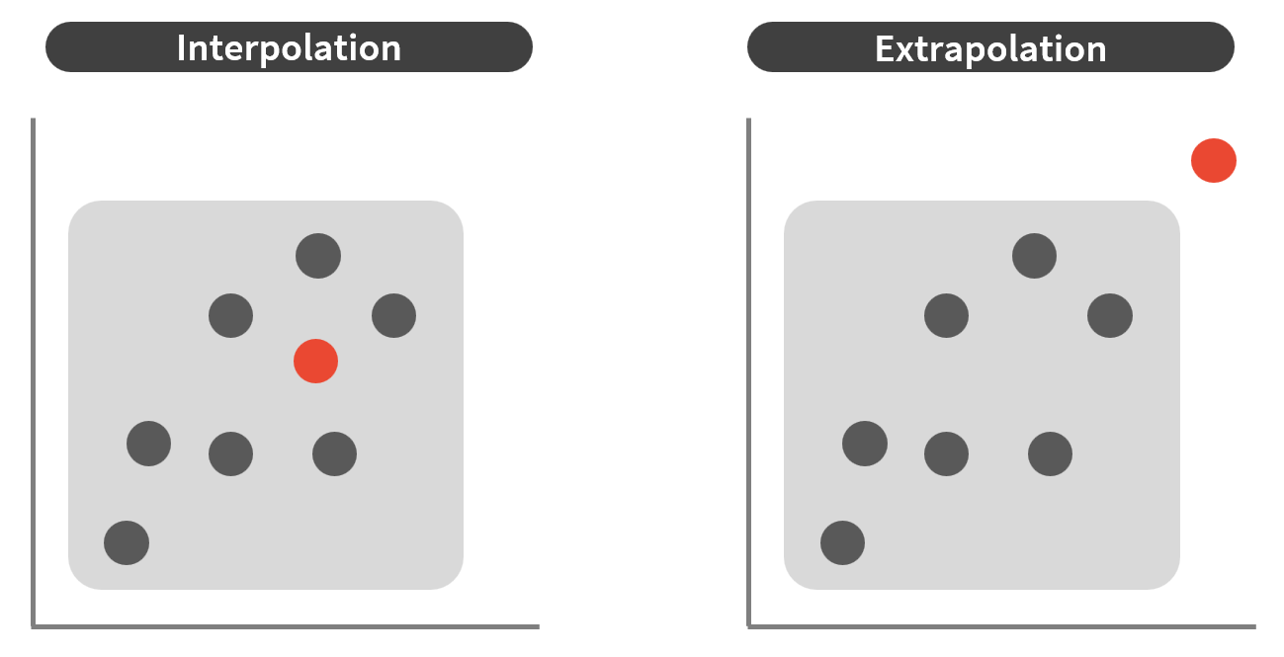

Defining the project
$$1+2+3$$

Slide 3
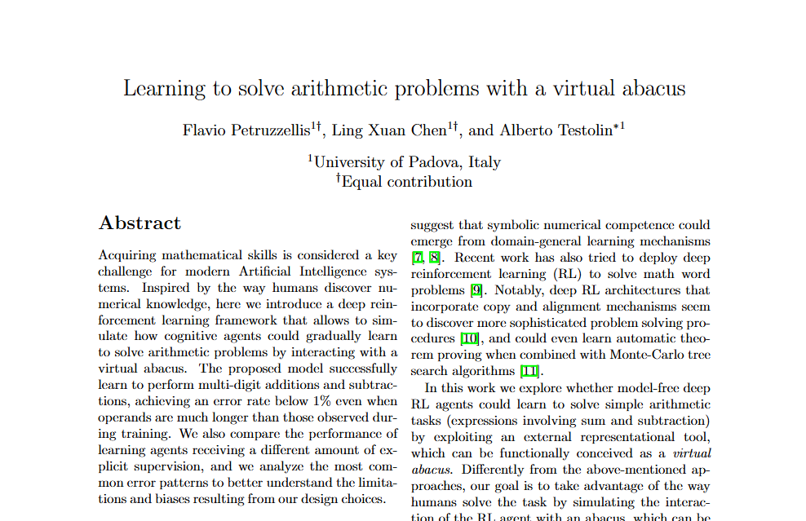

Slide 4
Why is this interesting?
Neural networks struggle with arithmetic problems
Mathematical cognition would be useful to Neural Networks

Slide 5
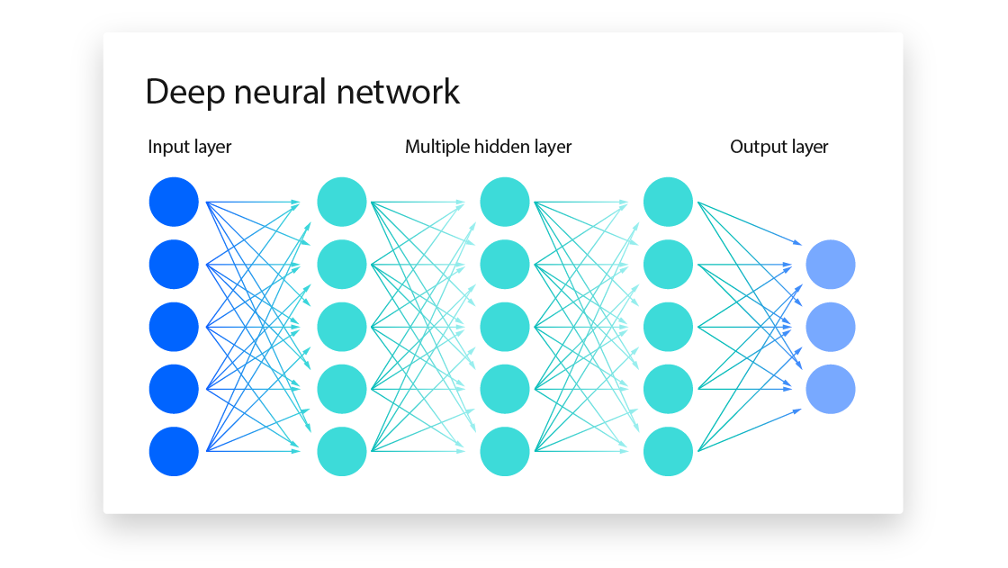
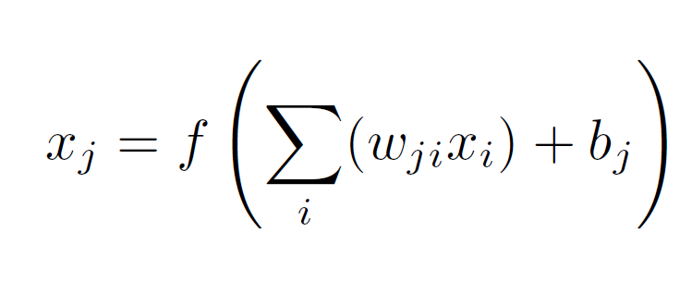
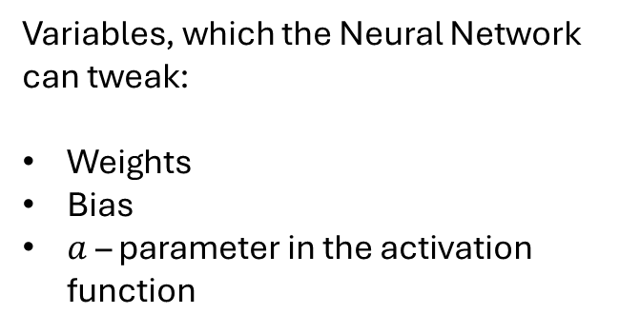
Small refresher: Neural networks
Variables, which the Neural Network can tweak:
Weights
Bias
$a$ – parameter in the activation function

Slide 6
Literature Study
A lot of research
Many interesting and useful finds for the project

